Slide 1
Standard RAID levels
The most commonly used RAID levels are:
• RAID 0: Split set
• RAID 1: Set in mirror
• RAID 5: Divided set with distributed parity

Slide 2
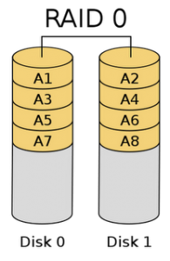
RAID 0
Example: RAID 0 with two physical disks
The information is distributed among all the real disks, so that a virtual disk whose size is the sum of the disks that make up the RAID is obtained. There is no data redundancy, but the access times to the information are higher, since we can access data located in the two disks in parallel.
Performance (very good read and write performance) Great utilization of capacity (better than any of the other configurations).
It does not offer data redundancy. Poor MTTF .
100% storage efficiency assuming the discs have the same capacity

Slide 3
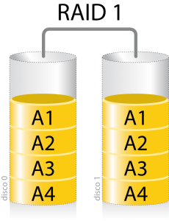
RAID 1
In RAID 1 what is done is to duplicate the information between the discs that form it. In this way, a virtual disk of the same size of each disk is obtained, but as the information is repeated, availability is improved.
Example: RAID 1 with two physical disks
Great redundancy and data availability Great MTTF.
The worst utilization of the capacity of simple RAID levels Good read performance but limited script performance.
50% storage efficiency assuming the discs are the same size

Slide 4
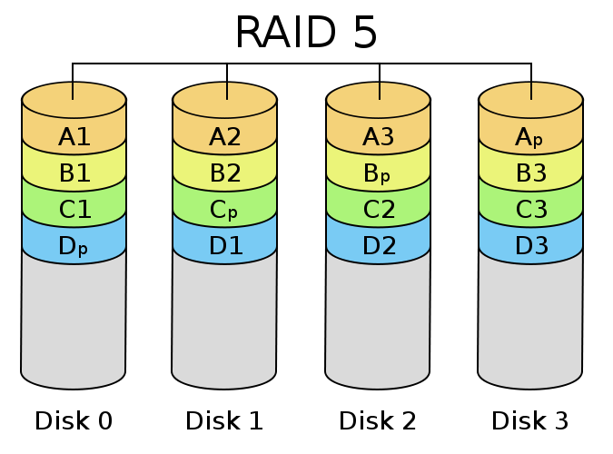
Raid 5
In this case, the information is distributed among several physical disks and, in addition, for each data set that is distributed between the disks, a parity data block is established, which contains a code to verify the correctness of the data of the data. other discs. That code also allows regenerating the lost data in case a physical disk fails.

Slide 5
Nested RAID levels
Many controllers allow the nesting of RAID levels, that is, a RAID can be used as a basic element of another instead of physical disks.
RAID 0+1: A mirror of divisions
RAID 1 + 0: A division of mirrors
RAID 30: A division of RAID levels with dedicated parity
RAID 100: A division of a mirror division
RAID 10 + 1: A Mirror of mirrors

Slide 6
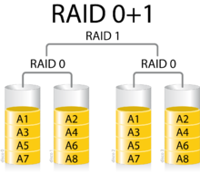
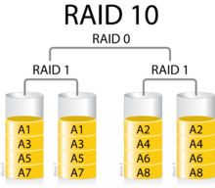
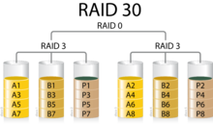
RAID 0+1
used to replicate and share data between multiple disks
RAID 0+1
all discs can fail except one without losing data. However, if the failed discs are not replaced, the remaining becomes a single point of failure for the whole assembly.
RAID 30
allows one disk to fail from each RAID 3 set. Until these failed disks are replaced, the other disks in each set that suffered the failure are single points of failure for the entire RAID 30 set

Slide 7
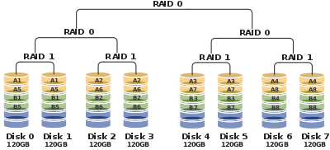
RAID 100
All but one disk could fail on each RAID 1 without losing data. However, the remaining disk of a RAID 1 thus becomes a single point of failure for the degraded array. Often the highest level of division is made by software.
RAID 10+1
It is a system of high availability per network, which allows the replication of data between cabinets at the RAID level, which greatly simplifies the cabins replication management.

